Slide 1

By: Git Dat Money (Group 1A) Paniz Herrera, Jahnavi Brahmbhatt, Brandon Meyer, Aidan Surowiec, Ignacio Velazquez
Capstone Project: Movie Analysis
March 2, 2023

Slide 2






Group 1A
Git Dat Money
Paniz Herrera
Aidan Surowiec
Risk & Advisory Analyst – Cyber Security
Cyber Strategy
Customer & Marketing Analyst – Advertising, Marketing & Commerce
Sub-Capacity: Data Science, Analytics, Personalization
Jahnavi Brahmbhatt
Ignacio Velazquez
Risk & Advisory Analyst – Cyber Security
Cyber Application
Strategy & Analysis
Artificial Intelligence
Brandon Meyer
Strategy & Analytics – Machine Learning Analyst

Slide 3
Agenda
1
Overview
Business understanding
2
Data Understanding
Data Analysis
3
Statistical Inference
4
Recommendations
Next Steps

Slide 4
Business Understanding
Evaluating the opportunity at hand for Computing Vision
MARKET TREND
Company-original video content is on the rise, viewers are engaging more and more
BUSINESS OPPORTUNITY
To position wisely, Computing Vision should create original content
STRATEGICAL APPROACH
Analyze movies to gain insights into success factors in efforts to take a calculated approach towards allocating content creation budget

Slide 5




Data Understanding
Overview of data sources, and information gained from each
2 Data Sets
1 Data Set
1 Data Set
1 Data Set
Used for Movie Attributes | Used for Financial Analysis
Important Columns | Genre Director Writer
Limited number of box office observations. | Limited number of box office observations, primary purpose of data is not financial
Used for Movie Review / Rating Analysis | Used for Financial Analysis
Important Columns | Fresh
Utilized Fresh/Rotten score to standardize review analysis. | Both tables were joined to analyze reviews based on movie attributes Added column to return 1 if review is fresh (good), and 0 if rotten (bad)
Used for Financial Analysis | Used for Financial Analysis
Important Columns | Title Production Budget Domestic Gross Worldwide Gross
Domestic Gross & Worldwide Gross are a sum of only box office income. Added column: “Profit”, to find difference between Worldwide Gross & Product Budget. | Domestic Gross and Worldwide Gross are a sum of only box office income Added column, “Profit”, to find difference between Worldwide Gross and Product Budget
Used for Movie Characteristics & Ratings | Used for Financial Analysis
Important Columns | Title Vote Average Original Language
Used for Financial Analysis | Used for Financial Analysis
Important Columns | Title Studio Domestic Gross Foreign Gross
Domestic Gross & Foreign Gross are a sum of only box office income. | Domestic Gross and Foreign Gross are a sum of only box office income
Both tables were joined to analyze reviews based on movie attributes​.

Slide 6
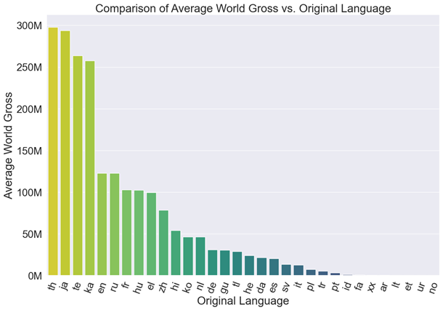
Worldwide Gross vs. Original Language
Analysis of Original Language
Our Analysis found that the Thai had the highest Worldwide gross while English had the 5th highest.
The Second highest language was Japanese.
The Top 5 languages are
Thai
Japanese
Telugu
Georgian
English
Notes:
Jahnavi Slide: Worldwide Gross v Original Language

Slide 7
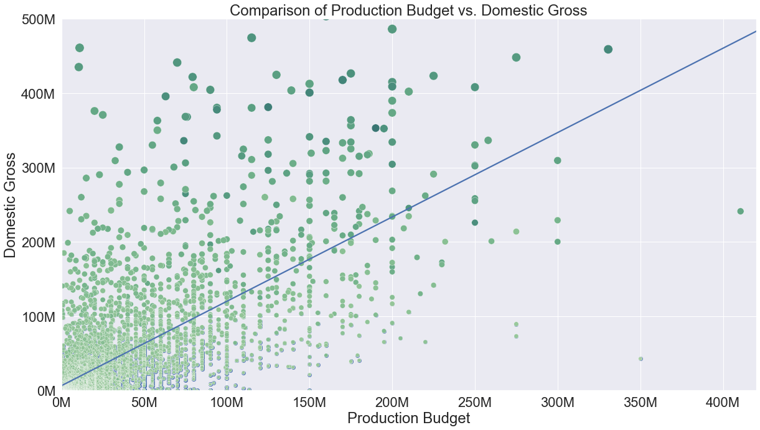
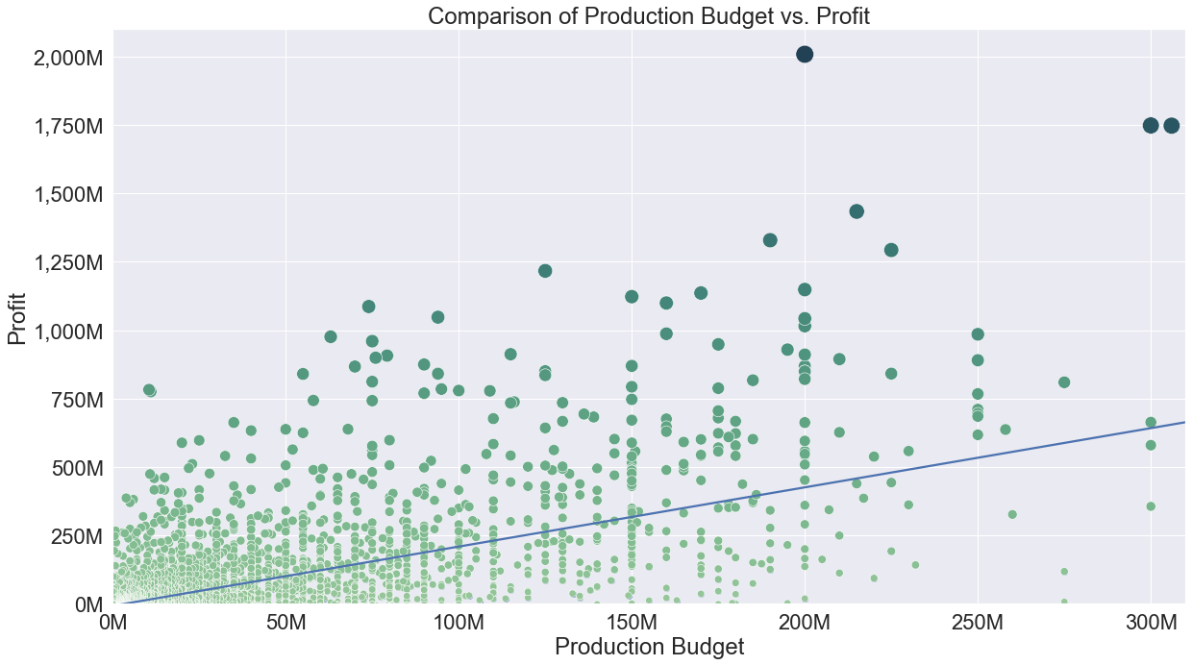
The Impact of Budget with Domestic & Worldwide Gross
The positive correlation of production budget compared to gross revenue streams.
Positive correlation on both aspects
Worldwide market does bring in more revenue

Slide 8
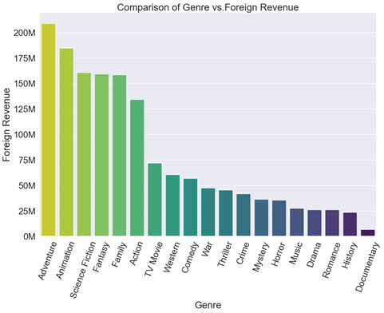
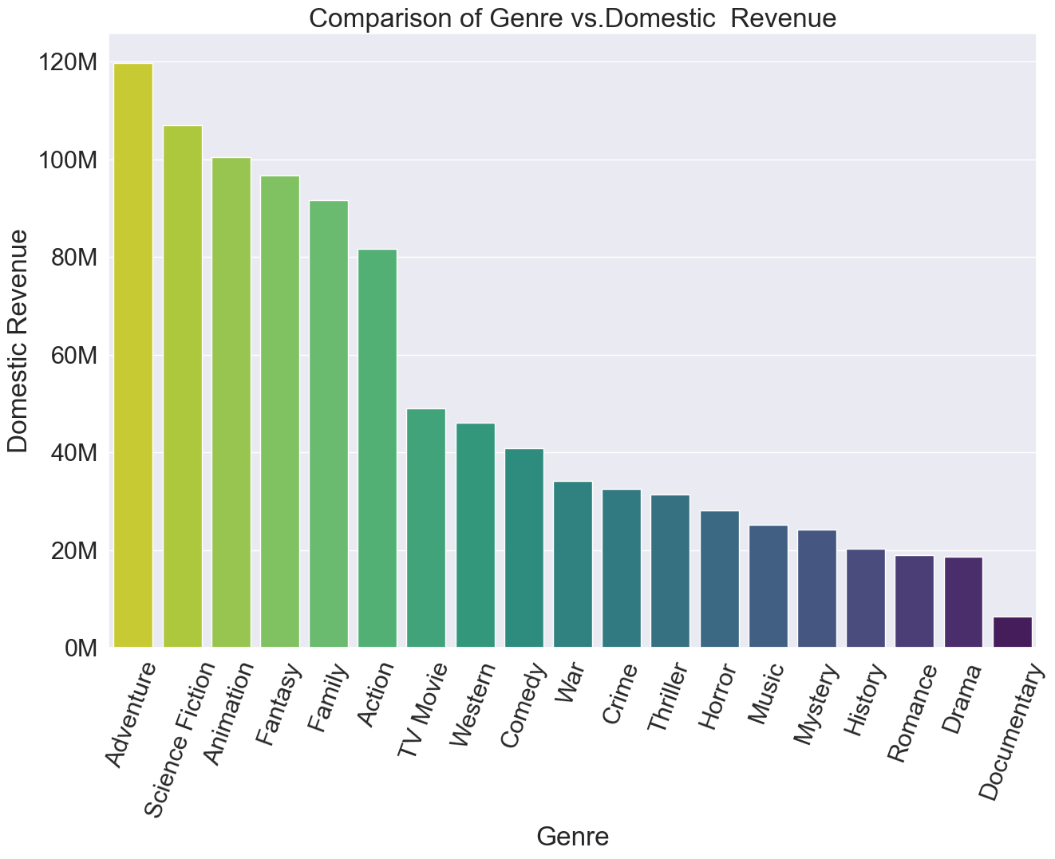
Genre V Foreign Revenue
Our Analysis found that the Adventure Genre had the highest Revenue in both foreign revenue and domestic Revenue, while the Documentary Genre had the lowest revenue.
Business recommendation is to invest in the top 3 genres for maximum returns (Adventure, Animation, Science Fiction)
Analysis of Genre and Foreign Revenue
Notes:
Jahnavi Slide: Genre V Revenue

Slide 9
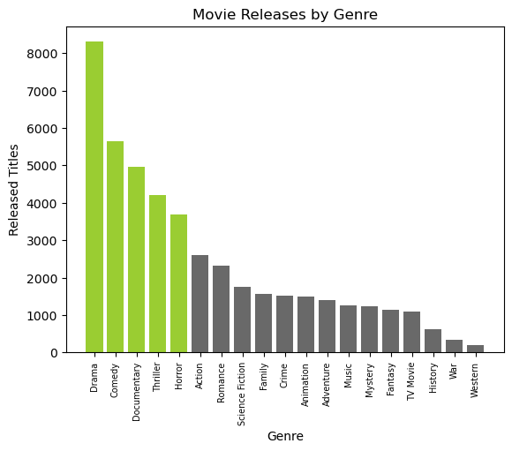
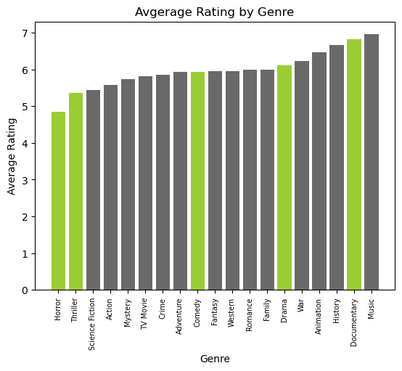
Genre against Popularity Analysis
Top 5 most produced genres: Drama, Comedy, Documentary, Horror, Thriller
Adventure tends to rate decently and not very produced (market space)
Extracted from Box Office and Rotten

Slide 10
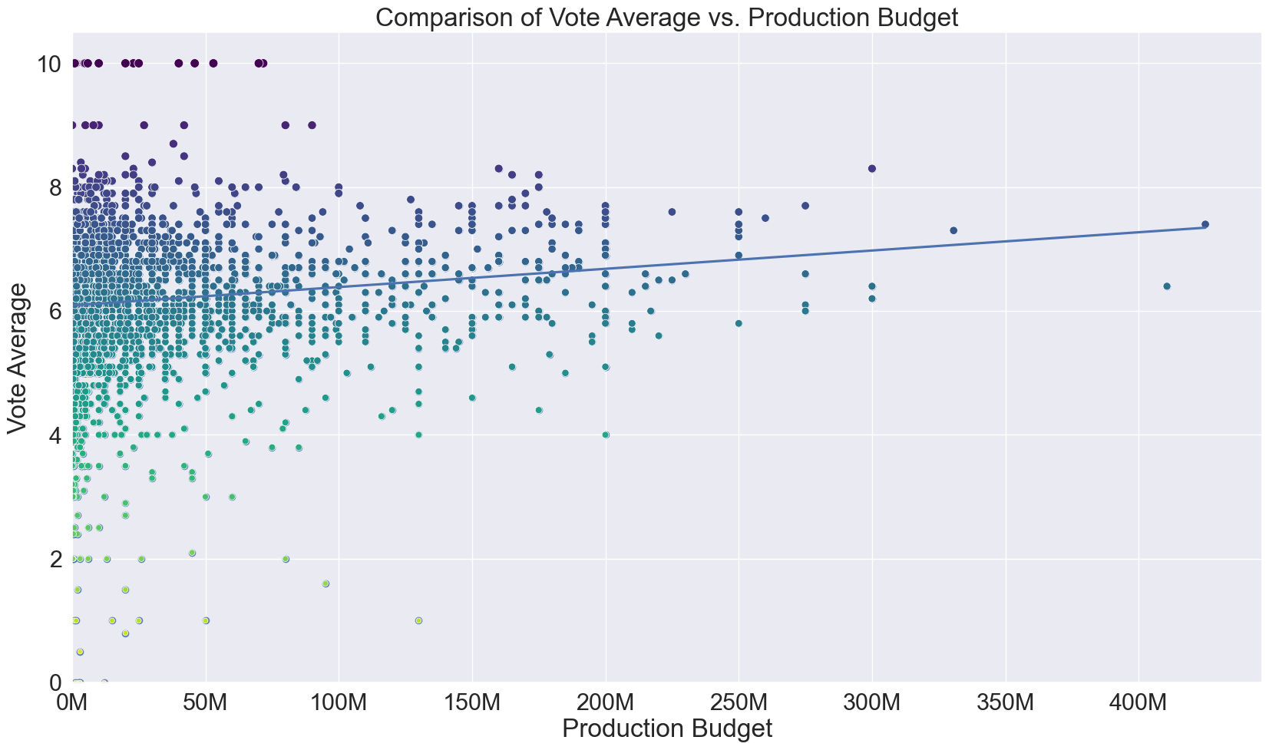
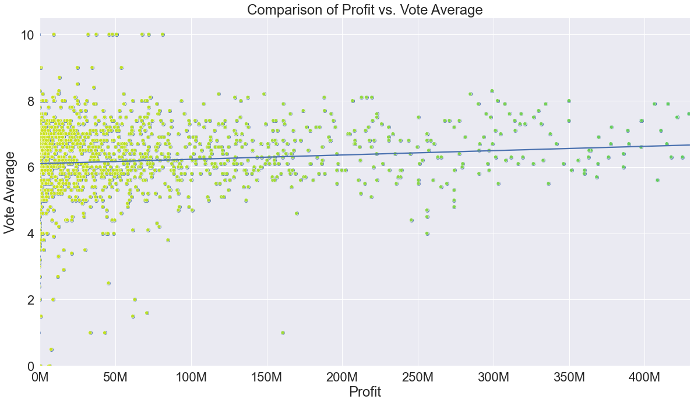
Vote average Analysis
Analysis of relationship between financial outcomes of a movie vs. how highly they were rated
TAKEAWAY
Insights drawn from analysis:
There is a visible positive relationship between vote average and production budget
Higher production budgets lead to movies with higher ratings
There is a slight positive relationship between profit* and vote average (movie rating)
Movies with high ratings bring in more profit
Movies on the higher end of the profit scale generally do not have a vote average less than 6
Movie Budget vs. Average Rating
Movie Profit vs. Average Rating
Notes:
Jahnavi Slide: Worldwide Gross v Original Language

Slide 11
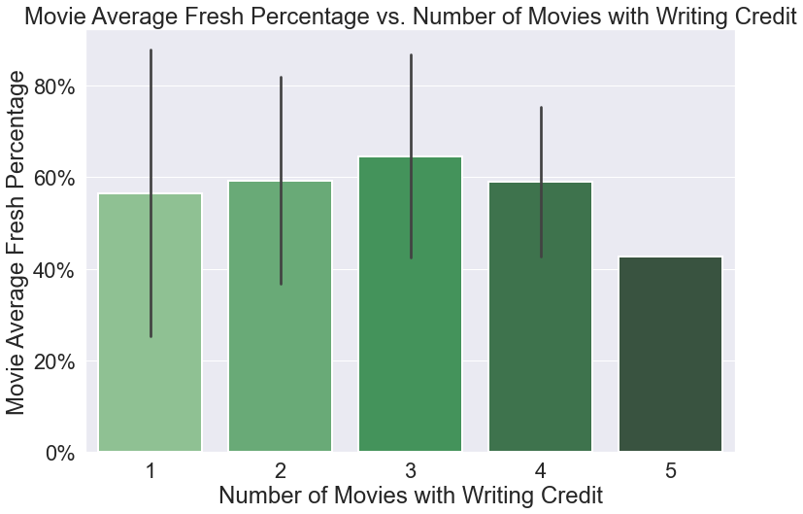
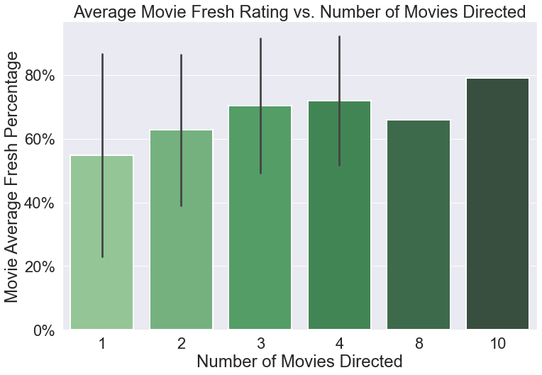
Director & Writer Analysis
Analysis of relationship between ratings and individual directors and writers
TAKEAWAY
Insights drawn from analysis:
In general, there appears to be a positive relationship between average movie fresh percentage and number of films a director has made
First time directors have the largest variance in average fresh percentage
The number of movies a writer has worked on does not seem to have a relationship with average movie fresh rating
Inferring that more experienced directors lead to higher rated movies
Writer Comparison
Director Comparison
Notes:
Jahnavi Slide: Worldwide Gross v Original Language

Slide 12
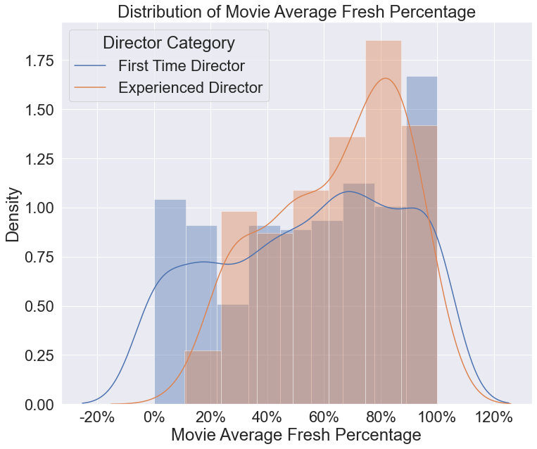
Hypothesis Testing
Does director experience lead to a higher average percentage of fresh ratings on Rotten Tomatoes?
Null Hypothesis: The distributions of movie average fresh percentage for first time directors are statistically similar to experienced directors
Alternative Hypothesis: The distributions of movie average fresh percentage for experienced directors are higher than for first time directors
Testing Conclusion:
Using a Mann-Whitney U test we conclude that the movie average fresh percentage is significantly greater for movies that were directed by a director who has worked on 2 or more movies
Key Variable: Fresh Percentage
Taken from Rotten Tomatoes reviews, for each movie take the sum of all fresh (good) reviews and divide by total number of reviews
Key Variable: Movie Average Fresh Percentage
Once grouped by director, an average of fresh percentage is returned using the sum of all percentages divided by the number of movies directed

Slide 13
Recommendations for Computing Vision
To maximize profitability the company should implement these recommendations
HIRE EXPERIENCED DIRECTORS
PRODUCE AN ADVENTURE MOVIE
FOCUS ON THAI AND JAPANESE LOCALIZATIONS
Directors with more than one movie under their belt tend to have better rated movies.
Our analysis indicates it is the most profitable genre and is averagely reviewed.
For an international release, the Asian market should be prioritized
Notes:
Jahnavi Slide: Worldwide Gross v Original Language

Slide 14
Going Forward (Next Steps)
Applying these recommendations
NEAR-TERM
MEDIUM-TERM
LONG-TERM

Slide 15
Going Forward (Next Steps)
Applying these recommendations

Slide 16
THANK YOU
Contact Info
Jahnavi Brahmbhatt
Email: jabrahmbhatt@deloitte.com
Paniz Herrera
Email:
Ignacio Ferrera
Email:
Brandon Cancino
Email: bcancinomeyer@deloitte.com
Aidan Surowiec
Email: asurowiec@deloitte.com

